Slide 1

Department of ECE
EMBEDDED PROTOTYPE
Smart Adaptive Traffic System using STM32
GUIDED BY:-
Dr.N.PRABAKARAN Associate Professor Dept of ECE
PRESENTED BY:-
2300040011 J.Vinay Kumar
2300040042 N.Hema Sundhar
2300040133 V.Kumar Raja

Slide 2



Objective
To design a smart traffic control system using STM32.
To reduce traffic congestion using adaptive timing.
To prioritize emergency vehicles automatically.
To improve road safety.
Traffic efficiency

Slide 3
Problem Statement
Fixed-time traffic signals cause unnecessary delays.
Heavy congestion during peak hours.
Increased fuel consumption and pollution.

Slide 4
Hardware & Software Tools
Hardware components:
STM32 Microcontroller Board
IR Sensors
Traffic Signal LEDs (Red, Yellow, Green)
LCD Display
Power Supply
Connecting Wires & Breadboard
Software components:
STM32CubeIDE
Embedded C Program

Slide 5
Block Diagram
IR Sensors
STM32 Controller
Traffic Lights
LCD Display

Slide 6
Methodology
Detect vehicle density using sensors.
Send sensor data to STM32.
Analyzes traffic density.
Adjust signal timing dynamically.
Repeat process continuously.

Slide 7
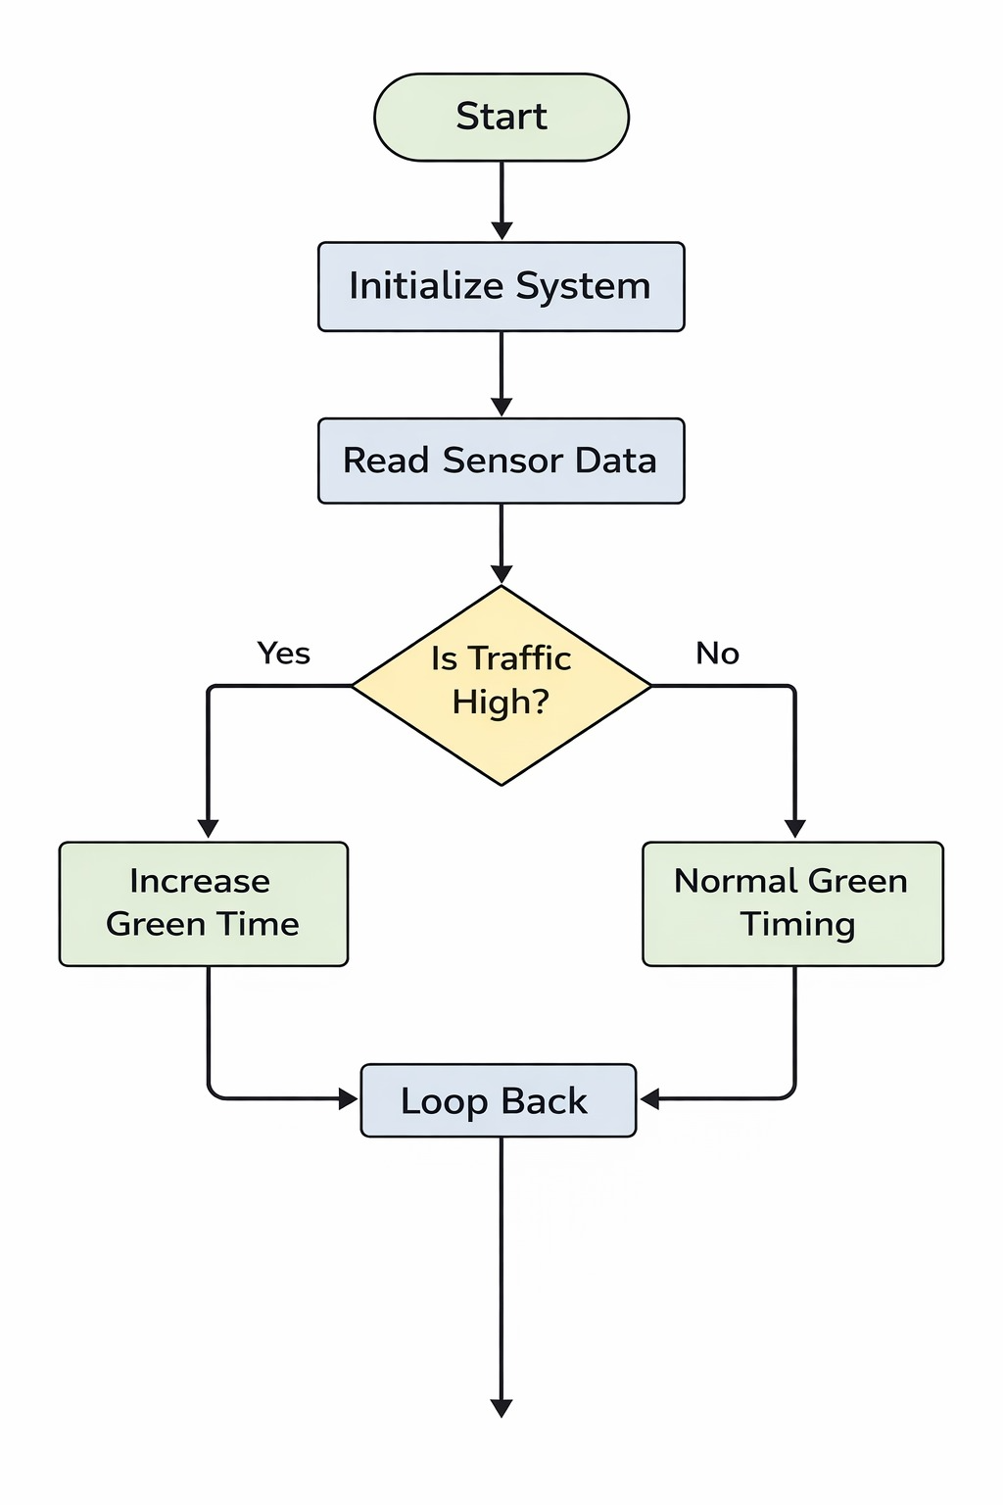
Flowchart

Slide 8
Conclusion
Smart adaptive system reduces congestion.
Efficient use of traffic signal timing.
Saves fuel and reduces pollution.
Can be extended with IoT and AI features.

Slide 9


THANK YOU
EMBEDDED PROTOTYPE

